Slide 1

Terra at 25: Illuminating Earth's Story (Problem Statement)
NASA's Terra satellite, launched in 1999, celebrates 25 years of continuous Earth observation. Equipped with five powerful instruments, it provides daily data that unveils both scientific insights and real-world environmental impacts, making it a cornerstone of global climate and ecological monitoring.

Slide 2




The Instruments Powering Terra's Vision
ASTER
MISR
MODIS
Advanced Spaceborne Thermal Emission and Reflection Radiometer maps land surfaces and topography with stunning detail.
Multi-angle Imaging SpectroRadiometer studies aerosols and clouds to track air quality changes.
Moderate Resolution Imaging Spectroradiometer monitors global vegetation, oceans, and atmosphere daily.
These tools, operating simultaneously for over 9,000 days, build a vast archive of Earth's dynamic portrait.

Slide 3

Deforestation: Losing Our Green Legacy
Terra's Eye on Forest Loss
ASTER and MODIS imagery documents a 10% decline in global forest cover since 2000, with hotspots like the Amazon losing 420,000 square kilometres. This drives biodiversity collapse and carbon release, exacerbating climate change.
Yearly loss: Equivalent to 50 football pitches per minute
Environmental toll: Habitat destruction for countless species
In your community, this means disrupted weather patterns and potential water shortages from eroded soils.

Slide 4
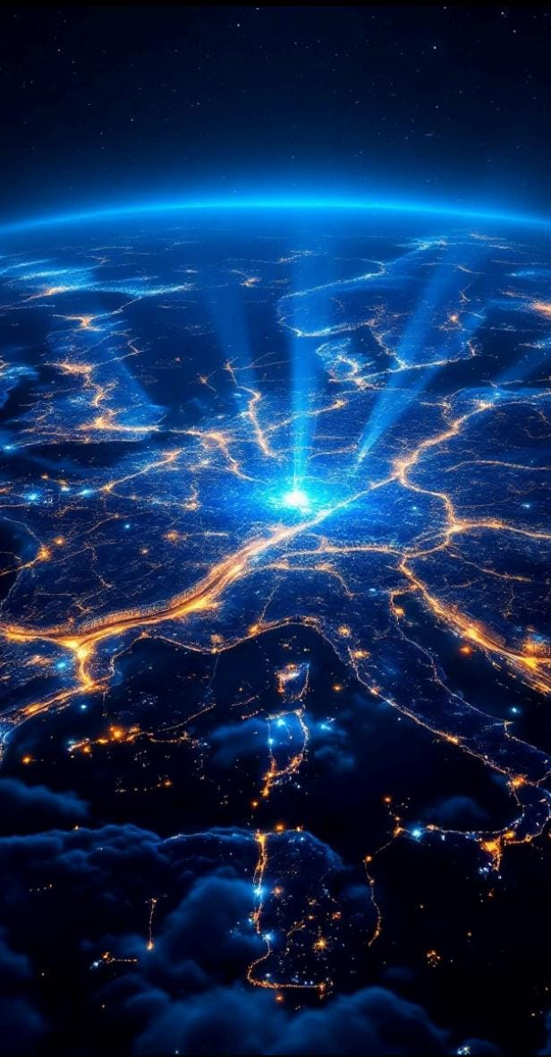
Urban Growth: Cities Expanding
1999 Baseline
Terra captures initial urban footprints, showing cities like London at 1,572 km².
2010 Expansion
Growth to 1,750 km², with MODIS detecting heat islands and sprawl.
2024 Today
Now 2,000 km², revealing infrastructure strain and green space loss.
This urban boom affects local environments through pollution and habitat fragmentation, impacting community health and wildlife corridors.

Slide 5


Ocean Health: Vital Signs from Afar
MISR and MODIS data highlight ocean warming and acidification, with sea surface temperatures up 0.13°C per decade. Coral bleaching events have surged 4-fold since Terra's launch.
Coastal Communities
Ocean Acidification
Temperature Rise
Pollution
Marine Life Impact
For coastal communities, this translates to eroded shorelines, disrupted fisheries, and economic pressures on livelihoods.

Slide 6

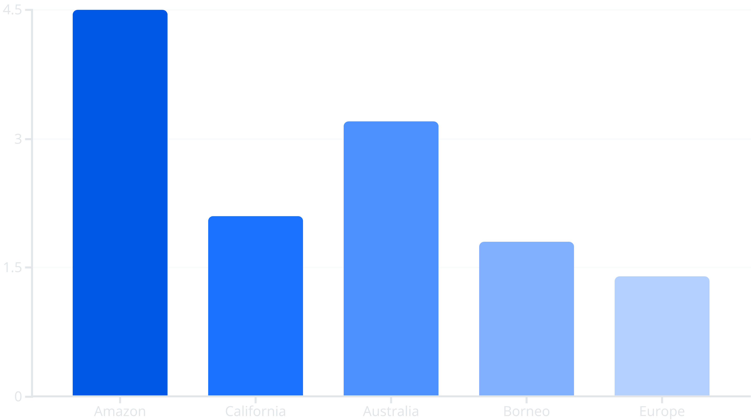

Air Quality: Breathing Easier with Data
30%
PM2.5 Reduction
Urban areas show cleaner air due to regulations informed by Terra.
20%
MODIS detects over 15 million fires since 1999, linking them to drought and land use. In 2023 alone, global burns emitted 8 billion tonnes of CO2.
Aerosol Tracking
MISR monitors wildfire smoke and industrial pollutants globally.

Slide 7
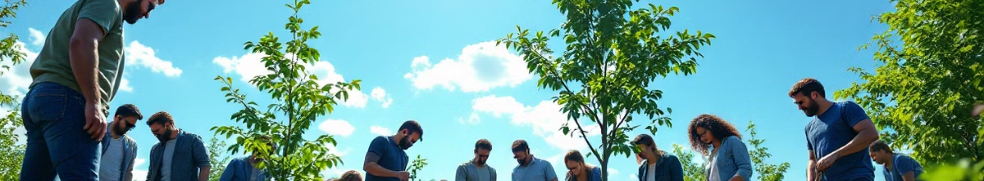
Impacts Close to Home: Your World Transformed
Community Resilience
Environmental Stewardship
Daily Decisions
Terra data informs disaster preparedness, from flood mapping to heatwave warnings, safeguarding lives in vulnerable areas.
Insights drive conservation efforts, preserving parks and reducing pollution for healthier neighbourhoods.
From farming efficiency to urban planning, Terra's legacy empowers sustainable choices in your daily life.
These stories show how satellite science touches us all, fostering a sustainable future.

Slide 8
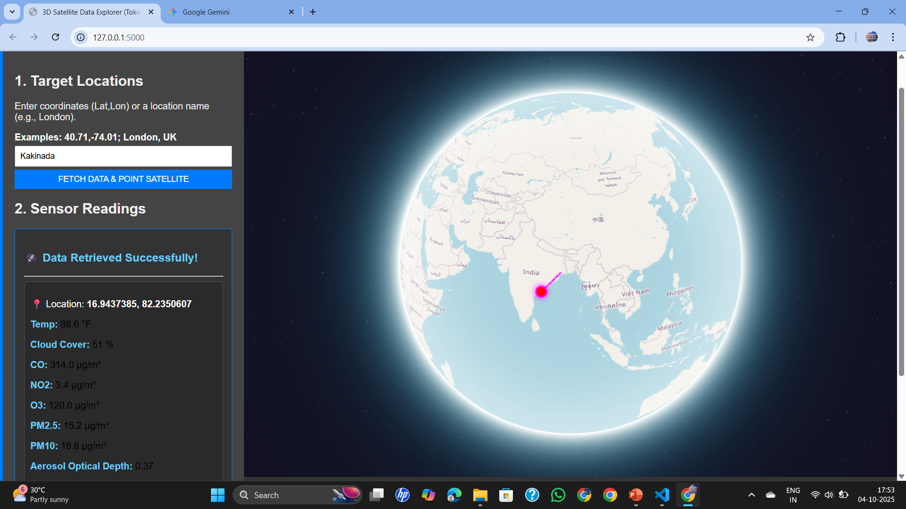
Based on the code provided, the solution is a web application that combines a Python backend and an HTML/JavaScript frontend to solve the problem statement. The Python component acts as a data processor, fetching real-time environmental data for a given location, while the frontend visualizes this data on a 3D interactive globe. This system effectively simulates a satellite's function, allowing users to visualize and explore real-time Earth science data for any location they choose. The animated visualization provides a clear and engaging way to understand the data's impact on the environment.
Based on the code provided, the solution is a web application that combines a Python backend and an HTML/JavaScript frontend to solve the problem statement. The Python component acts as a data processor, fetching real-time environmental data for a given location, while the frontend visualizes this data on a 3D interactive globe. This system effectively simulates a satellite's function, allowing users to visualize and explore real-time Earth science data for any location they choose. The animated visualization provides a clear and engaging way to understand the data's impact on the environment.
Terra's Enduring Legacy: Looking Ahead
Based on the code provided, the solution is a web application that combines a Python backend and an HTML/JavaScript frontend to solve the problem statement. The Python component acts as a data processor, fetching real-time environmental data for a given location, while the frontend visualizes this data on a 3D interactive globe. This system effectively simulates a satellite's function, allowing users to visualize and explore real-time Earth science data for any location they choose. The animated visualization provides a clear and engaging way to understand the data's impact on the environment.

Slide 9
"Terra doesn't just observe Earth—it helps us protect it."
THANK YOU

